Slide 1
Characteristics of estimators: Consistency
Session 5
13/03/2021

Slide 2
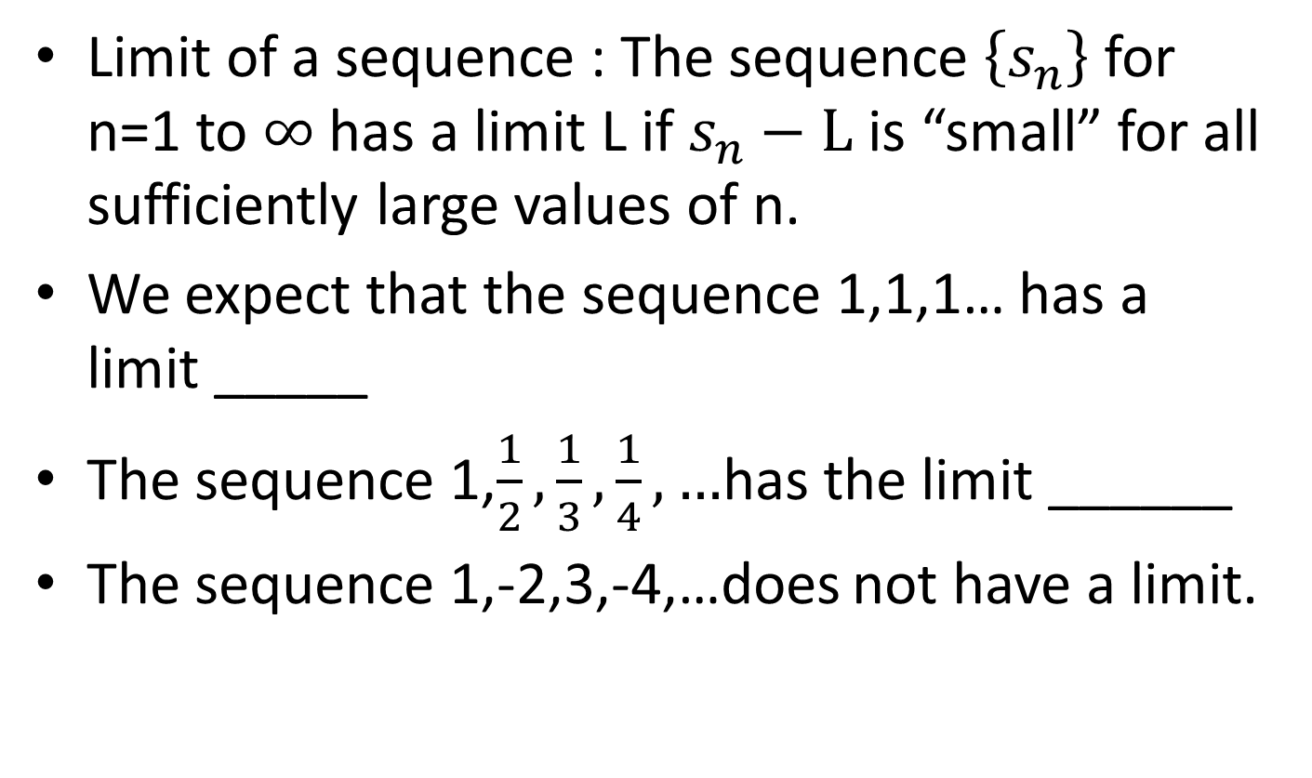
Basic concepts
Limit of a sequence : The sequence $\left\{s_{n}\right\}$ for n=1 to $∞$has a limit L if $s_{n}−L$ is “small” for all sufficiently large values of n.
We expect that the sequence 1,1,1… has a limit _____
The sequence 1,$\frac{1}{2},\frac{1}{3},\frac{1}{4},…$has the limit ______
The sequence 1,-2,3,-4,…does not have a limit.

Slide 3
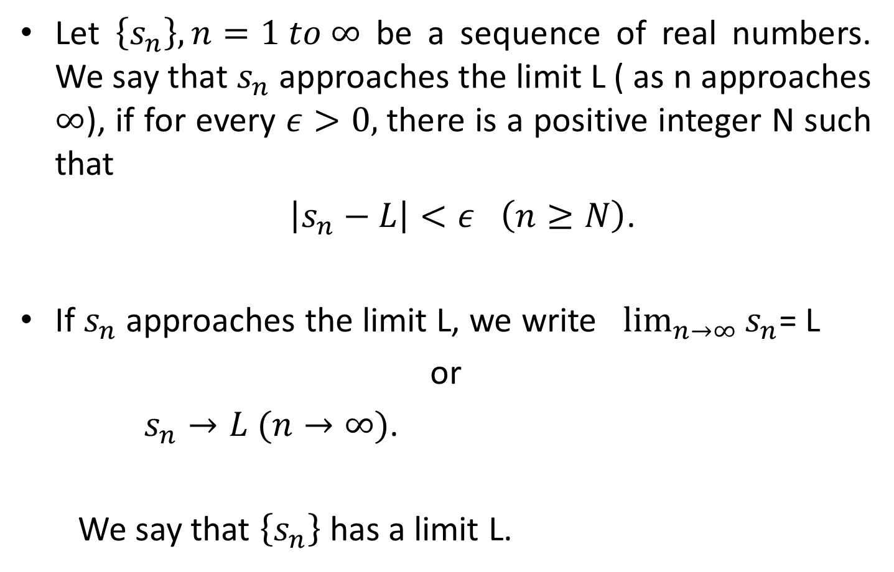
Limit Definition
Let $\left\{s_{n}\right\}, n=1 to ∞$ be a sequence of real numbers. We say that $s_{n}$ approaches the limit L ( as n approaches $∞$), if for every $ε>0,$there is a positive integer N such that
$\left|s_{n}−L\right|<ε$ $\left(n≥N\right)$.
If $s_{n}$ approaches the limit L, we write $\lim_{n→∞}{s_{n}}$= L
or
$s_{n}→L (n→∞)$.
We say that $\left\{s_{n}\right\}$has a limit L.

Slide 4
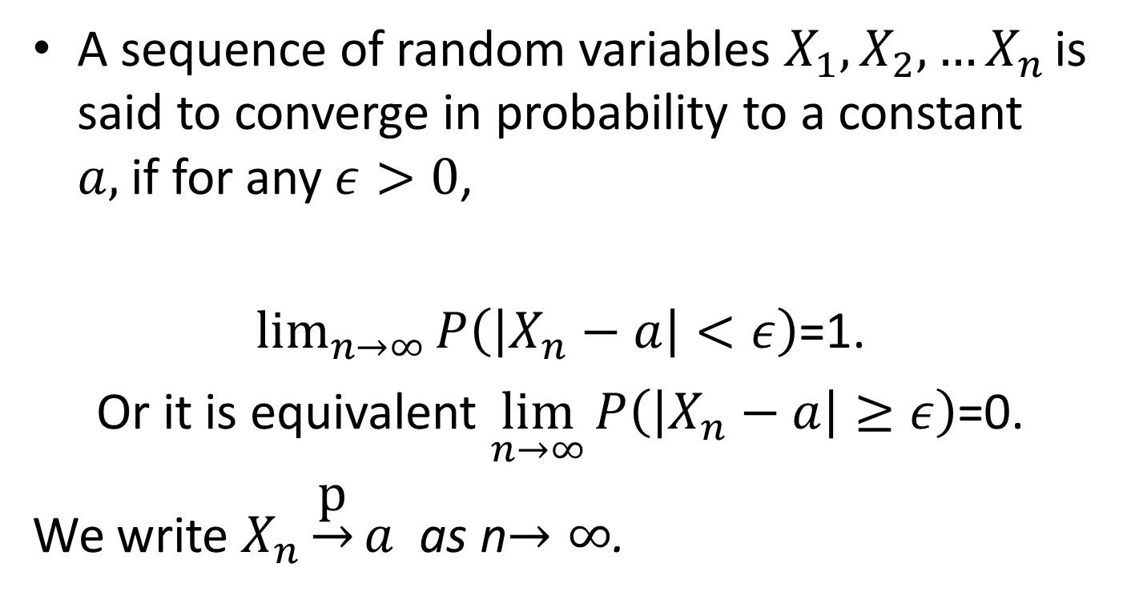
Convergence in probability
A sequence of random variables $X_{1},X_{2},…X_{n }$is said to converge in probability to a constant $a,$if for any $ε>0$,
$\lim_{n→∞}{P\left(\left|X_{n}−a\right|<ε\right)}$=1.
Or it is equivalent $\lim_{n→∞}{P\left(\left|X_{n}−a\right|≥ε\right)}$=0.
We write $X_{n}\underset{→}{\text{p}}a$ as n$→∞$.

Slide 5
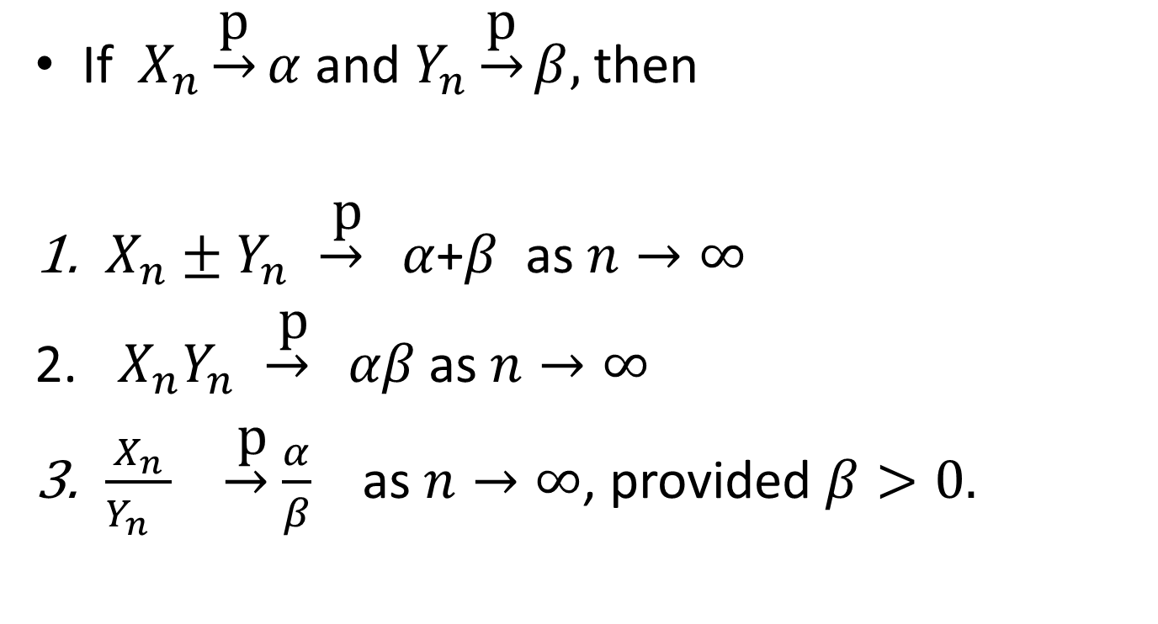
Results
If $X_{n}\underset{→}{\text{p}}α$and $Y_{n}\underset{→}{\text{p}}β,$then
$X_{n}±Y_{n }\underset{→}{ \text{p}} α$+$β$ as $n→∞$
$X_{n}Y_{n }\underset{→}{ \text{p}} αβ$ as $n→∞$
$\frac{X_{n}}{Y_{n }}$ $\underset{→}{ \text{p}} \frac{α}{β}$ as $n→∞$, provided $β>0.$

Slide 6
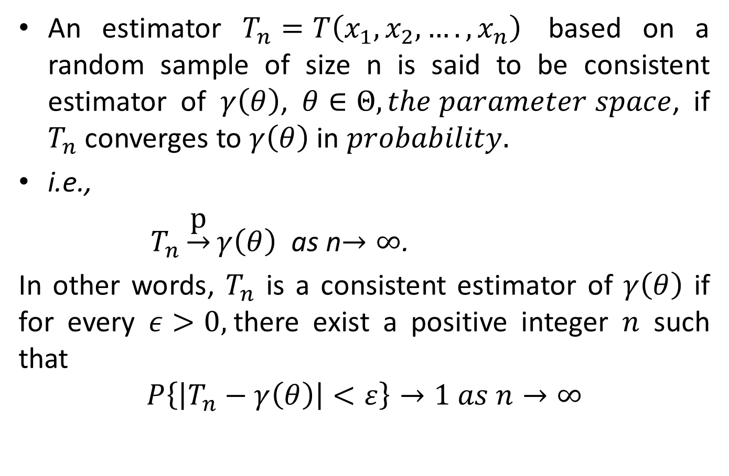
Consistency
An estimator $T_{n}=T\left(x_{1},x_{2},….,x_{n}\right)$ based on a random sample of size n is said to be consistent estimator of $γ\left(θ\right)$, $θ∈Θ, the parameter space$, if $T_{n}$ converges to $γ\left(θ\right)$ in $probability.$
i.e.,
$T_{n}\underset{→}{\text{p}}γ\left(θ\right)$ as n$→∞$.
In other words, $T_{n}$ is a consistent estimator of $γ\left(θ\right)$ if for every $ε>0,$there exist a positive integer $n$ such that
$$P\left\{\left|T_{n}−γ\left(θ\right)\right|<ε\right\}→1 as n→∞$$

Slide 7
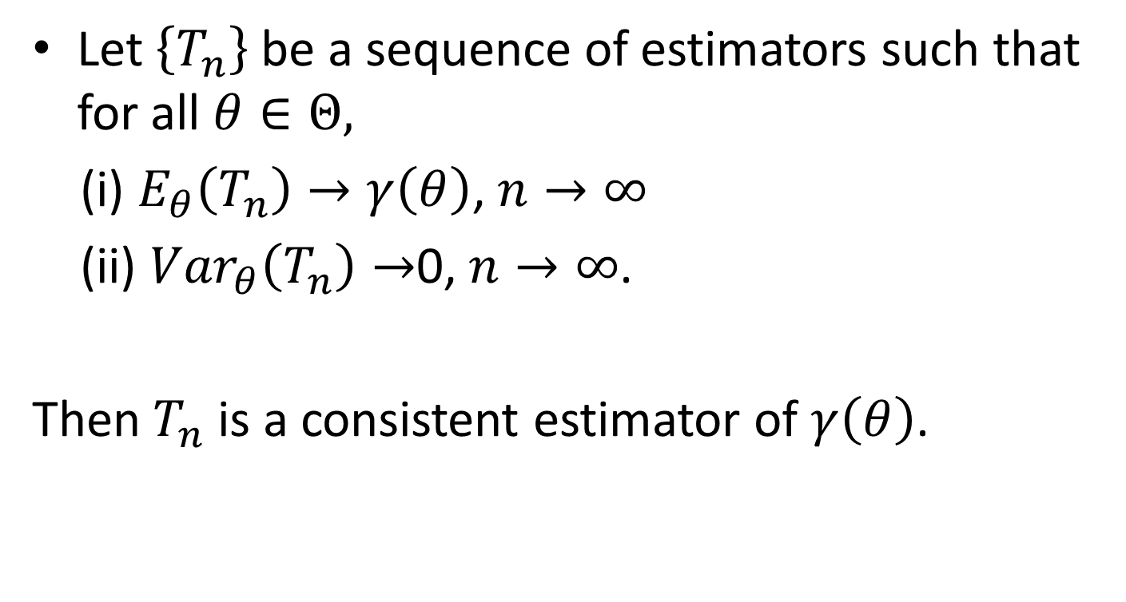
Sufficient conditions for consistency
Let $\left\{T_{n}\right\}$ be a sequence of estimators such that for all $θ∈Θ,$
(i) $E_{θ}\left(T_{n}\right)→γ\left(θ\right)$, $n→∞$
(ii) ${Var}_{θ}\left(T_{n}\right)→$0, $n→∞$.
Then $T_{n}$ is a consistent estimator of $γ\left(θ\right)$.

Slide 8
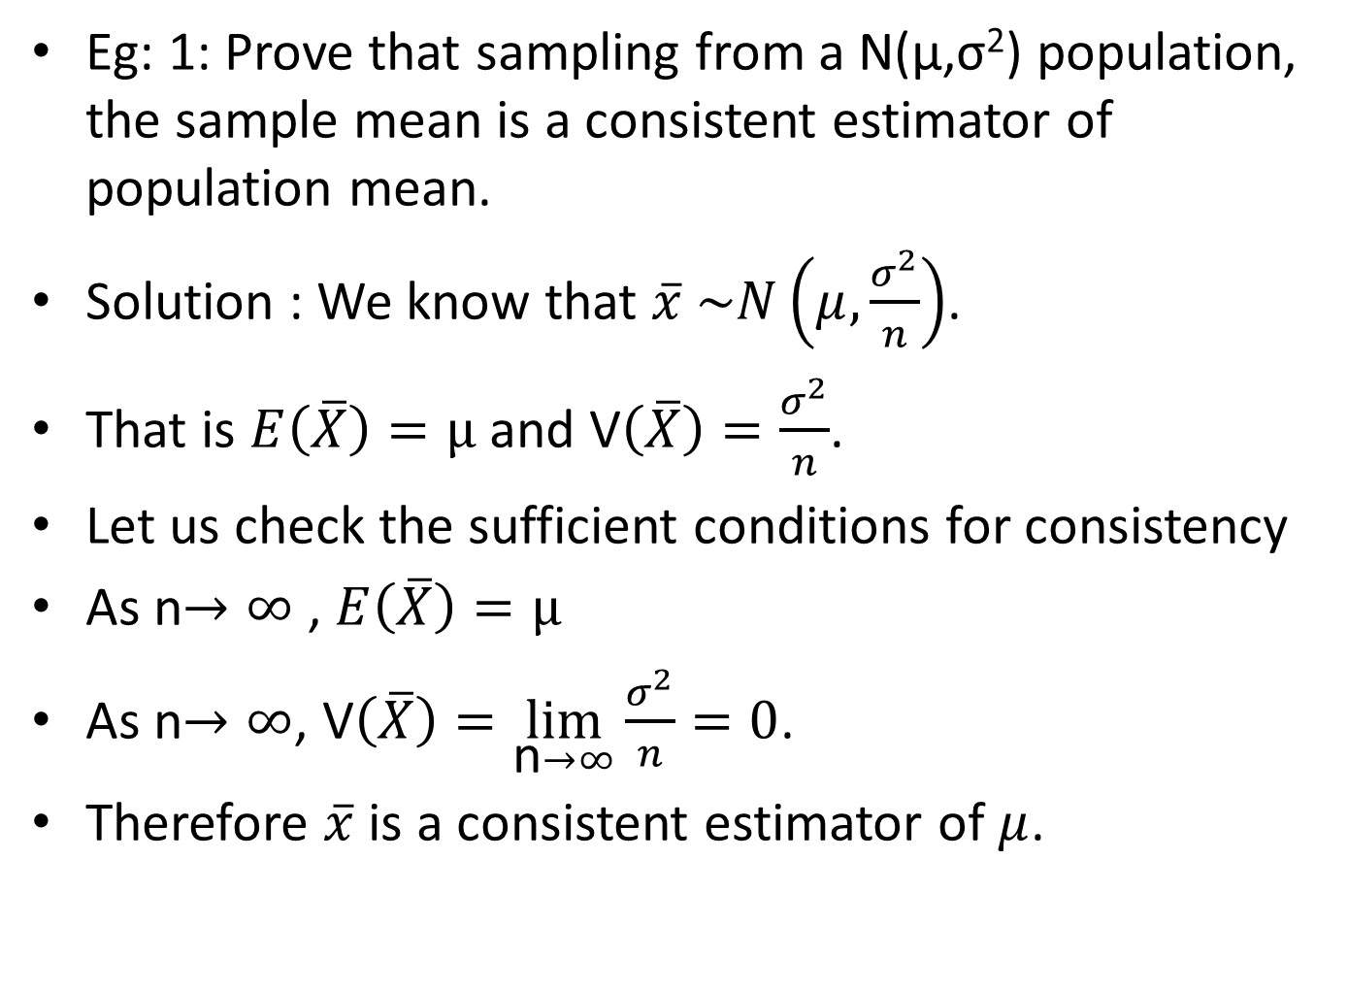
Eg: 1: Prove that sampling from a N(μ,σ²) population, the sample mean is a consistent estimator of population mean.
Solution : We know that $\overline{x} \sim N\left(μ,\frac{σ^{2}}{n}\right)$.
That is $E\left(\overline{X}\right)=μ$ and V$\left(\overline{X}\right)=\frac{σ^{2}}{n}$.
Let us check the sufficient conditions for consistency
As n$→∞$ , $E\left(\overline{X}\right)=μ$
As n$→∞$, V$\left(\overline{X}\right)=\lim_{\text{n}→∞}{\frac{σ^{2}}{n}=0}$.
Therefore $\overline{x}$ is a consistent estimator of $μ$.

Slide 9
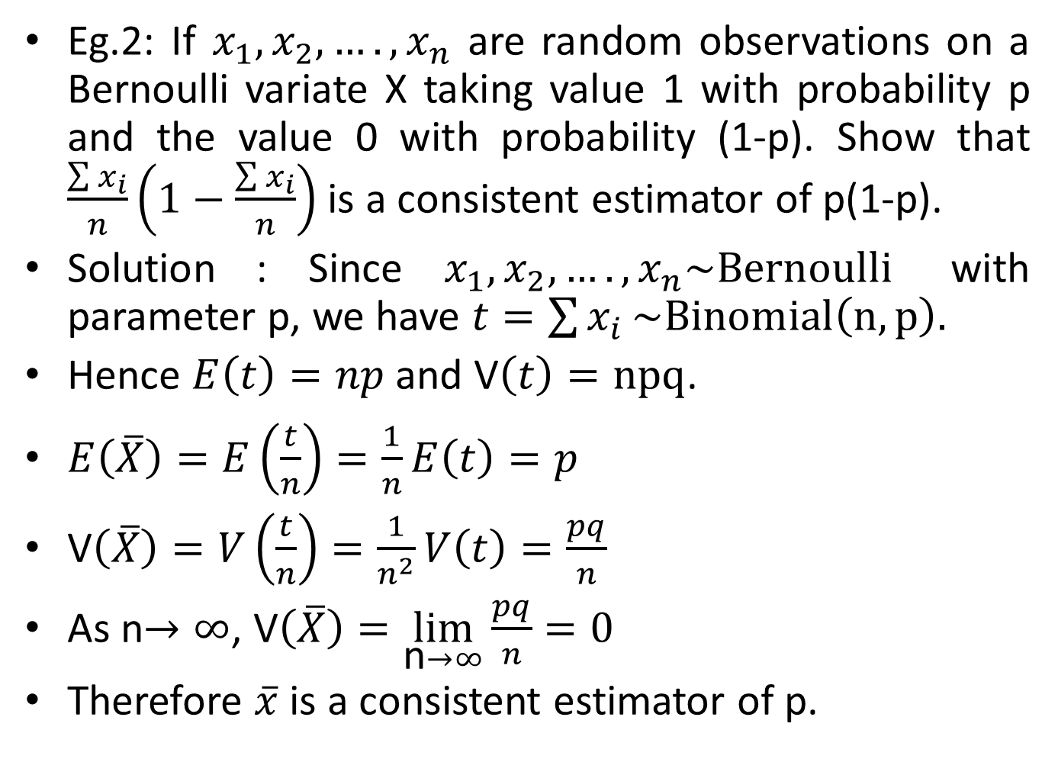
Eg.2: If $x_{1},x_{2},….,x_{n}$ are random observations on a Bernoulli variate X taking value 1 with probability p and the value 0 with probability (1-p). Show that $\frac{\sum{x_{i}}}{n}\left(1−\frac{\sum{x_{i}}}{n}\right)$ is a consistent estimator of p(1-p).
Solution : Since $x_{1},x_{2},….,x_{n}\sim Bernoulli$ with parameter p, we have $t=\sum{x_{i}}\sim Binomial\left(n,p\right).$
Hence $E\left(t\right)=np$ and V$\left(t\right)=npq$.
$E\left(\overline{X}\right)=E\left(\frac{t}{n}\right)=\frac{1}{n}E\left(t\right)=p$
V$\left(\overline{X}\right)=V\left(\frac{t}{n}\right)=\frac{1}{n^{2}}V\left(t\right)=\frac{pq}{n}$
As n$→∞$, V$\left(\overline{X}\right)=\lim_{\text{n}→∞}{\frac{pq}{n}=0}$
Therefore $\overline{x}$ is a consistent estimator of p.

Slide 10
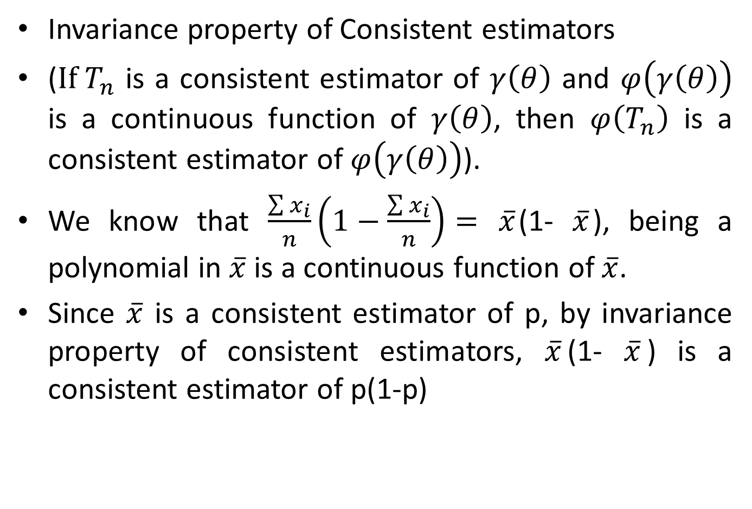
Invariance property of Consistent estimators
(${If T}_{n}$ is a consistent estimator of $γ\left(θ\right)$ and $φ\left(γ\left(θ\right)\right)$ is a continuous function of $γ\left(θ\right)$, then $φ\left(T_{n}\right)$ is a consistent estimator of $φ\left(γ\left(θ\right)\right)$).
We know that $\frac{\sum{x_{i}}}{n}\left(1−\frac{\sum{x_{i}}}{n}\right)=$ $\overline{x}$(1- $\overline{x}$), being a polynomial in $\overline{x}$ is a continuous function of $\overline{x}$.
Since $\overline{x}$ is a consistent estimator of p, by invariance property of consistent estimators, $\overline{x}$(1- $\overline{x}$) is a consistent estimator of p(1-p)

